Slide 1


Survival Prediction of Extracorporeal Membrane Oxygenation Treatment on Patients with Acute Respiratory Distress Syndrome
Robert Edwards

Slide 2
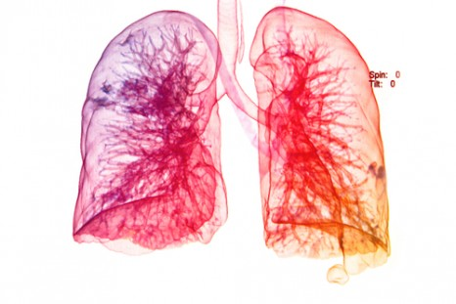
Introduction
Project background
Aims of the project
Exploratory data analysis
Methods
Advanced Section: Imputation
[image]

Slide 3
Project Background

Slide 4
Acute Respiratory Distress Syndrome (ARDS)
Common and often fatal cause of respiratory failure
Prevalence of 10% among critically ill patients worldwide^{1,2}
30-40% mortality^{1,2}
Defined as:
acute hypoxic respiratory failure (PaO₂/FiO₂ < 300 mmHg)
bilateral chest infiltrates
absence of cardiac failure as primary diagnosis
[1] Rubenfeld GD, Caldwell E, Peabody E, et al. Incidence and outcomes of acute lung injury. N Engl J Med 2005; 353: 1685–93.
[2] Bellani G, Laffey JG, Pham T, et al. Epidemiology, patterns of care, and mortality for patients with acute respiratory distress syndrome in intensive care units in 50 countries. JAMA 2016; 315: 788–800.
Notes:
https://www.nhs.uk/conditions/acute-respiratory-distress-syndrome/
Acute respiratory distress syndrome (ARDS) is a life-threatening condition where the lungs can't provide the body's vital organs with enough oxygen.
It's usually a complication of a serious existing health condition. Most people have therefore already been admitted to hospital by the time they develop ARDS.
Symptoms of ARDS can include:
severe shortness of breath
rapid, shallow breathing
tiredness, drowsiness or confusion
feeling faint

Slide 5
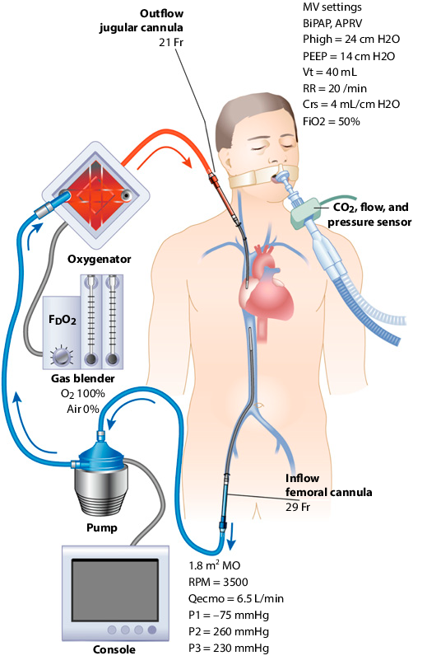
Extracorporeal Membrane Oxygenation
Extracorporeal membrane oxygenation (ECMO)
A method of providing extended cardiac and respiratory support in patients with insufficient gas exchange or perfusion to sustain life
Used with some success in treating cardiac [citation]
Research suggests it could help with ARDS patients^{3,4}
[3] Peek, GJ; Moore, HM; Moore, N; Sosnowski, AW; Firmin, RK (1997). "Extracorporeal membrane oxygenation for adult respiratory failure". Chest.
[4] Lewandowski, K.; Rossaint, R.; Pappert, D.; Gerlach, H.; Slama, K.-J.; Weidemann, H.; Frey, D. J. M.; Hoffmann, O.; Keske, U. (1997). "High survival rate in 122 ARDS patients managed according to a clinical algorithm including extracorporeal membrane oxygenation". Intensive Care Medicine.
[image] Combes A, Pesenti A, Ranieri VM. Fifty Years of Research in ARDS. Is Extracorporeal Circulation the Future of Acute Respiratory Distress Syndrome Management?. Am J Respir Crit Care Med. 2017 May 1;195(9):1161-1170. doi: 10.1164/rccm.201701-0217CP. Review. PubMed PMID: 28459322.
Notes:
1. A method of providing extended cardiac and respiratory support in patients with insufficient gas exchange or perfusion to sustain life
Early studies had shown survival benefit with use of ECMO for people in acute respiratory failure especially in the setting of acute respiratory distress syndrome.^{[6][7]}
Peek, GJ; Moore, HM; Moore, N; Sosnowski, AW; Firmin, RK (1997). "Extracorporeal membrane oxygenation for adult respiratory failure". Chest.
Lewandowski, K.; Rossaint, R.; Pappert, D.; Gerlach, H.; Slama, K.-J.; Weidemann, H.; Frey, D. J. M.; Hoffmann, O.; Keske, U. (1997). "High survival rate in 122 ARDS patients managed according to a clinical algorithm including extracorporeal membrane oxygenation". Intensive Care Medicine.
https://www.semanticscholar.org/paper/Fifty-Years-of-Research-in-ARDS.-Is-Extracorporeal-Leprince-Pesenti/ca0ada0ed074e8c7c09fe0fdfe2f084be0758563

Slide 6
Aims of Project
Can PreECMO biomedical markers be used to accurately predict survival after ECMO treatment?
Do we need all PreECMO variables or just a subset to make accurate predictions?
What is the expected performance of future predictions?
Notes:
**Should this have a title slide?

Slide 7
Exploratory Data Analysis

Slide 8
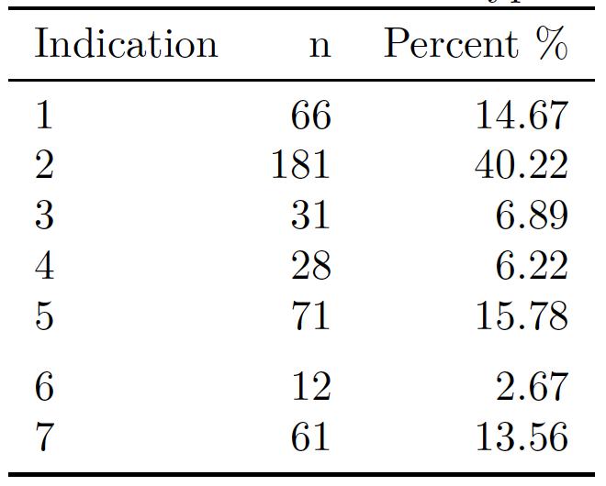
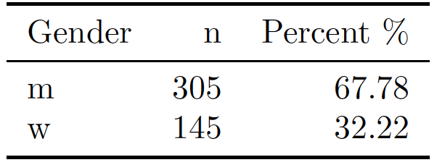
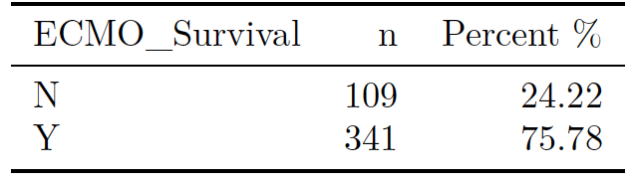
The Data
450 patients diagnosed with ARDS
33 explanatory variables
2 Categorical
31 Continuous
Binary response
Notes:
Imbalanced Data
Response variable ECMO_Survival
Gender
Disease Indication

Slide 9
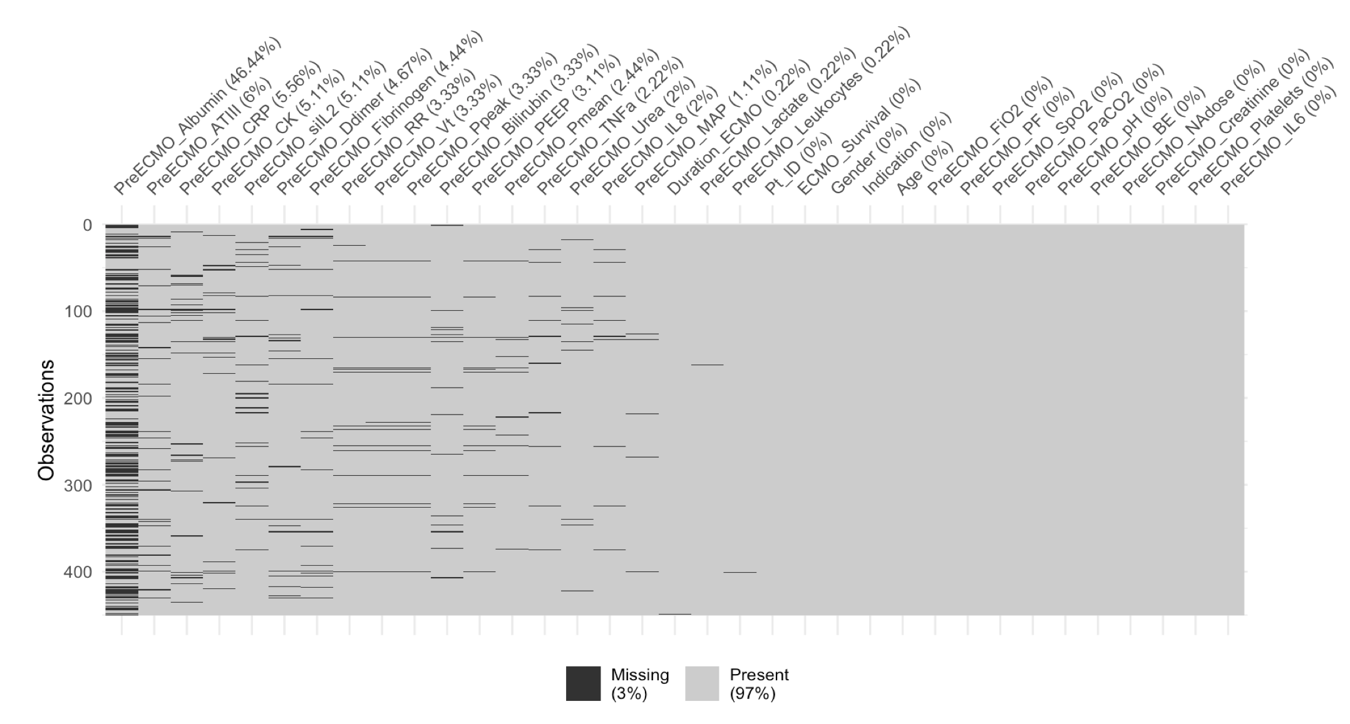
Missing Data
Drop

Slide 10
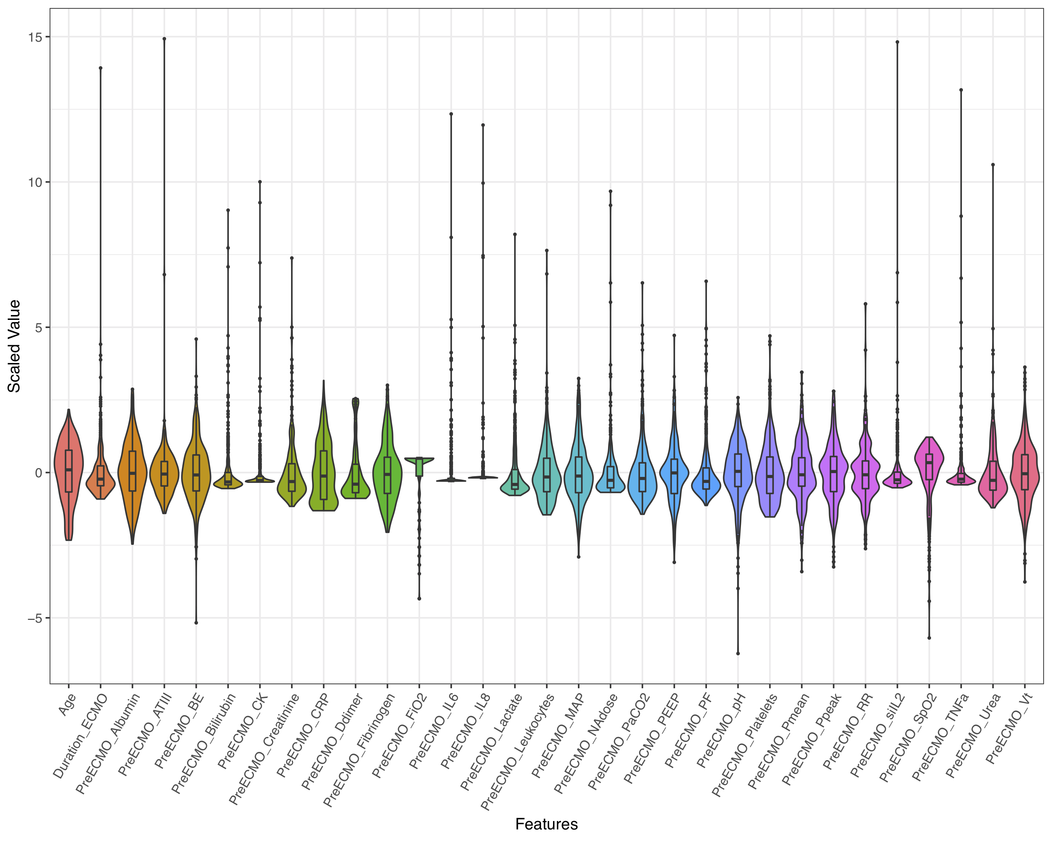
Violin Plot
Notes:
Many outliers
Highly skewed data

Slide 11
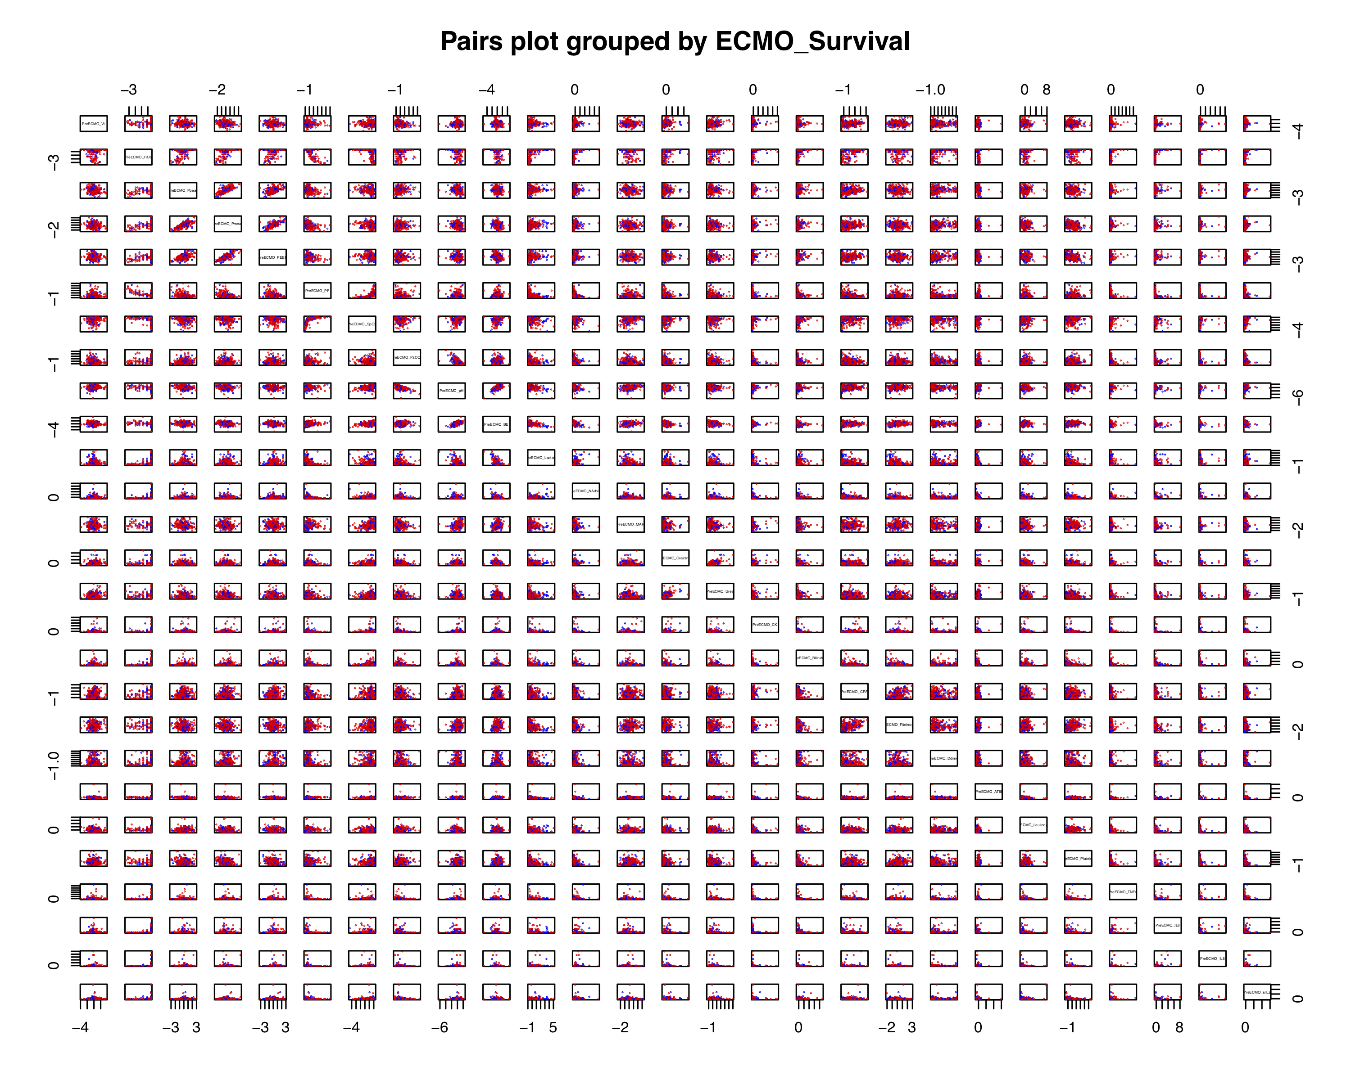
Pairs Plot
Notes:
No clear linear separations in ECMO_Survival
Variables showing some group distinction:
PreECMO_Lactate
PreECMO_pH

Slide 12
Methods

Slide 13
Models
Split Data
(train / validation / test)
Methods
Train Models
(training set)
Logistic Regression
Logistic Regression + LASSO
LDA
QDA
KNN
Classification Tree
Random Forest
Support Vector Classifier
Model Selection
(validation set)
Error Rate
ROC
AUC
F1 Score
Future Performance
(test set)
Notes:
ROC
AUC
F1 Score

Slide 14
Advanced Section: Imputation
Listwise Deletion
(n = 313)
Mean Imputation
(n = 450)
MICE Imputation
(n = 450)
Split Data
Split Data
Split Data
Train Models
Train Models
Train Models
Model Selection
Model Selection
Model Selection
Future Performance
Future Performance
Future Performance

Slide 15

Questions?
2416963E@student.gla.ac.uk

Slide 16
Bibliography

Slide 17
Hypothesis Tests

